Slide 1
Securing Apache Kafka
D Sai Natarajan
Duratech Solutions, 7200845985, d.sainatarajan@duratechsolutions.in

Slide 2
Outline
Kafka and security overview
Authentication
Identify the principal (user) associated with a connection
Authorization
What permission a principal has
Secure Zookeeper
Future stuff

Slide 3

Whats Apache Kafka
Distributed, high throughput pub/sub system
Notes:
New theme.
Picture/logo

Slide 4
Security Overview
Support since 0.9.0
Access control on resources such as topics
Enable sharing Kafka clusters
Wire encryption btw client and broker
For cross data center mirroring

Slide 5
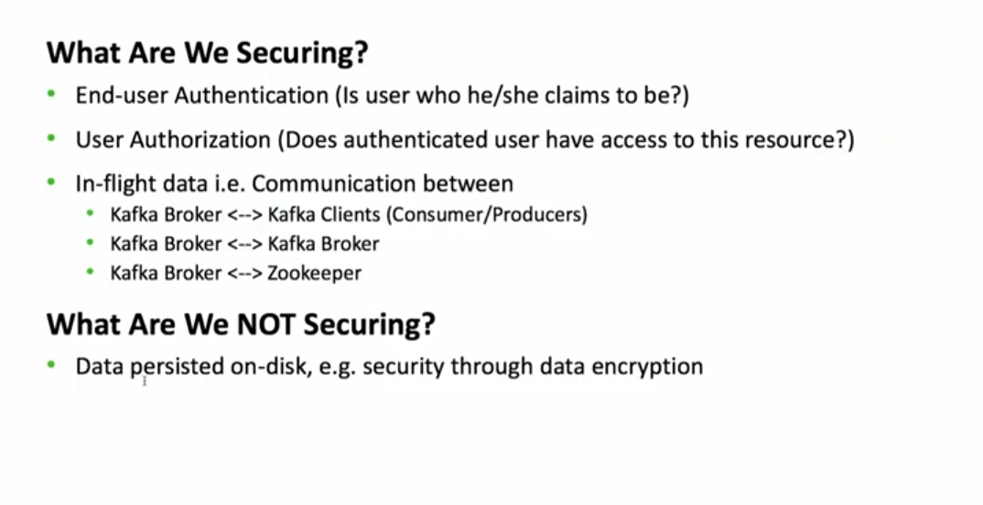
Security Overview

Slide 6
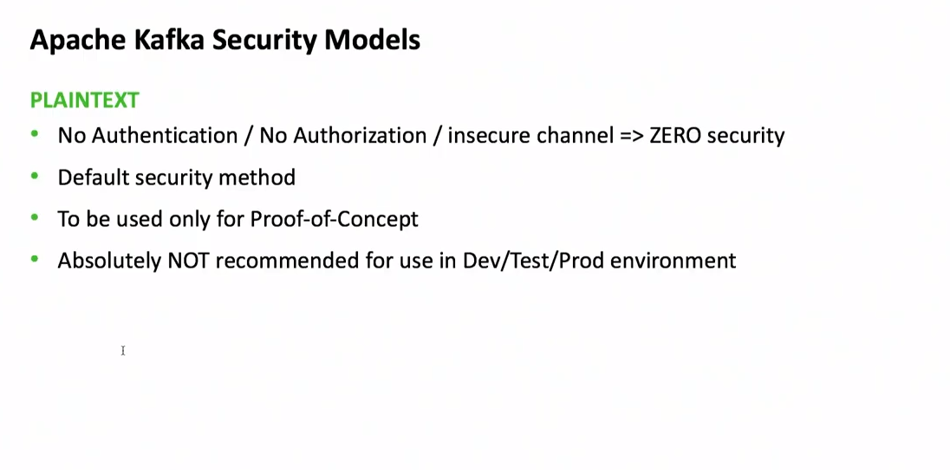

Slide 7
Why Kafka Security?
How can we prevent rogue agents to publishing/consuming data from Kafka
How can we encrypt the data that’s flowing through the network
How can we give permissions to a topic to specific group or users

Slide 8
Kafka Security
We recognized the necessity of security in Kafka
Added wire encryption via SSL
Role Based authentication via SASL ( Kerberos)
Authorizer to add fine-grain access controls to Kafka topics per User, per Host.

Slide 9
Authentication Overview
Authentication through SSL or SASL
Broker support multiple ports
plain text (no wire encryption/authentication)
SSL (for wire encryption/authentication)
SASL (for SASL authentication)
SSL + SASL (SSL for wire encryption, SASL for authentication)
Clients choose which port to use
need to provide required credentials through configs

Slide 10
Why is SSL useful
1-way authentication
Secure wire transfer through encryption
2-way authentication
Broker knows the identity of client
Easy to get started
Just involve client and server

Slide 11
Kafka Security – SSL
Kafka SSL / SASL requirements
No User-level API changes to clients
Retain length-encoded Kafka protocols
Client must authenticate before sending/receiving requests
Kafka Channel
Instead of using socket channel, we added KafkaChannel which consists a TransportLayer, Authenticator.

Slide 12
Kafka Security – SSL
SSLTransportLayer
Before sending any application data, both client and server needs to go though SSL handshake
SSLTransportLayer uses SSLEngine to establish a non- blocking handshake.
SSLEngine provides a state machine to go through several steps of SSLhandshake

Slide 13
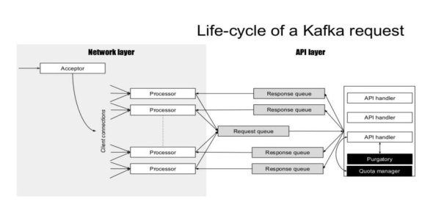
Kafka Networking
KafkaChannel
Kafka Server
handshake
TransportLayer
authenticate
Authenticator

Slide 14
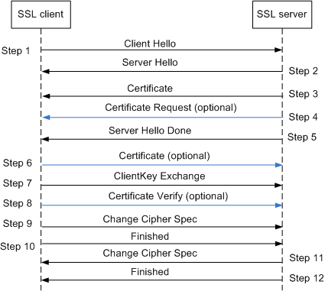
SSL handshake

Slide 15
Subsequent transfer over SSL
Data encrypted with agreed upon cipher suite
Encryption overhead
Throughput could decrease by upto 50%

Slide 16
Performance impact with SSL
r3.xlarge
4 core, 30GB ram, 80GB ssd, moderate network (~90MB/s)
Most overhead from encryption
 | throughput (MB/s) | CPU on client | CPU on broker
producer (plaintext) | 83 | 12% | 30%
producer (SSL) | 69 | 28% | 48%
consumer (plaintext) | 83 | 8% | 2%
consumer (SSL) | 69 | 27% | 24%

Slide 17
Preparing SSL
Generate certificate (X509) in broker key store
Generate certificate authority (CA) for signing
Sign broker certificate with CA
Import signed certificate and CA to broker key store
Import CA to client trust store
2-way authentication: generate client certificate in a similar way

Slide 18
Configuring SSL
No client code change; just configuration change.
Client/Broker
ssl.keystore.location = /var/private/ssl/kafka.server.keystore.jks
ssl.keystore.password = test1234
ssl.key.password = test1234
ssl.truststore.location = /var/private/ssl/kafka.server.truststore.jks
ssl.truststore.password = test1234
Broker
listeners = SSL://host.name:port
security.inter.broker.protocol = SSL
ssl.client.auth = required
Client
security.protocol = SSL

Slide 19
Kafka Security – SSL
Principal Builder
SSLTransportLayer gives hostname as authenticated user
X509Certificate has lot more information about a client identity.
PrincipalBuilder provides interface to plug in a custom PrincipalBuilder that has access to X509Certificate and can construct a user identity out of it.
Authenticator can use this custom principal to add ACLs

Slide 20
SSL Principal Name
By default, the distinguished name of the certificate
CN=host1.company.com,OU=organization unit,O=organization,L=location,ST=state,C=country
Can be customized through principal.builder.class
Has access to X509Certificate
Make setting broker principal and application principal convenient

Slide 21
Kafka Security – SSL
listeners=SSL://host.name:port
ssl.keystore.location
ssl.keystore.password
ssl.key.password
ssl.truststore.location
ssl.truststore.password
security.inter.broker.protocol (optional)

Slide 22
What is SASL
Simple Authentication and Security Layer
Challenge/response protocols
Server issues challenge and client sends response
Continue until server is satisfied
Different mechanisms
GSSAPI: Kerberos (supported since 0.9)
Plain: cleartext username/password (supported since 0.10)
Digest MD5

Slide 23
Kafka Security – SASL
Simple Authentication and Security Layer, or SASL
Provides flexibility in using Login Mechanisms
One can use Kerberos , LDAP or simple passwords to authenticate.
JAAS Login
Before client & server can handshake , they need to authenticate with Kerberos or other Identity Provider.
JAAS provides a pluggable way of providing user credentials. One can
easily add LDAP or other mechanism just by changing a config file.

Slide 24
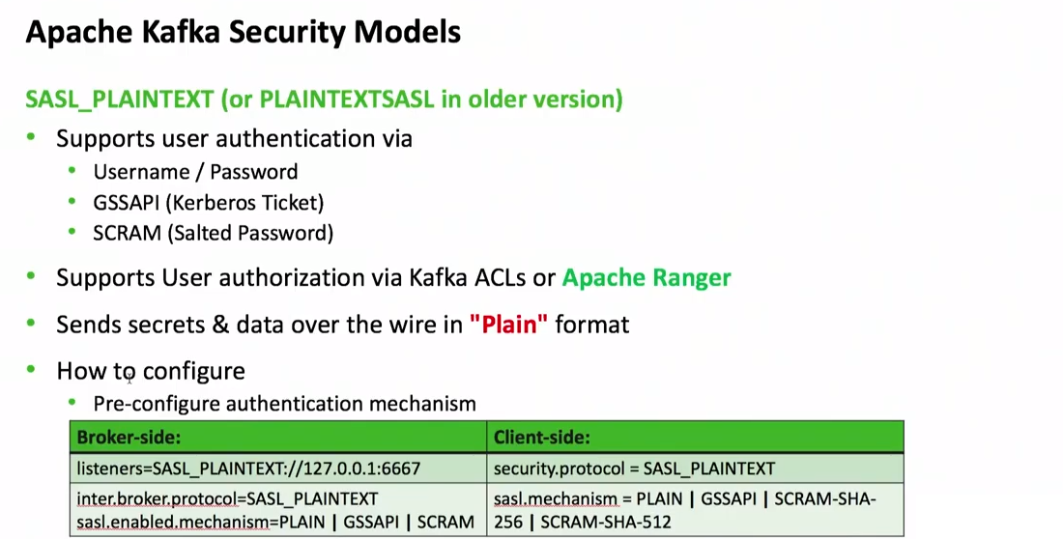

Slide 25
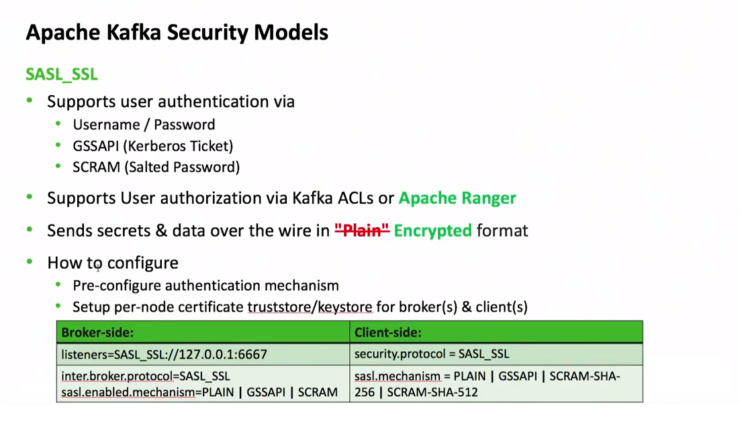

Slide 26
Why Kerberos
Secure single sign-on
An organization may provide multiple services
User just remember a single Kerberos password to use all services
More convenient when there are many users
Need Key Distribution Center (KDC)
Each service/user need a Kerberos principal in KDC

Slide 27
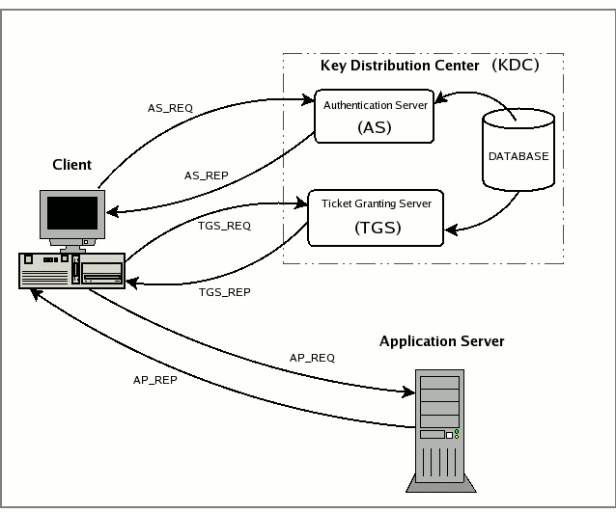
How Kerberos Works
Create service and client principal in KDC
Client authenticate with AS on startup
Client obtain service ticket from TGS
Client authenticate with service using service ticket

Slide 28
SASL handshake
Client
Broker
Connection
Mechanism list
Selected mechanism & sasl data
Evaluate and response
Sasl data
Client authenticated

Slide 29
Data transfer
SASL_PLAINTEXT
No wire encryption
SASL_SSL
Wire encryption over SSL

Slide 30
Preparing Kerberos
Create Kafka service principal in KDC
Create a keytab for Kafka principal
Keytab includes principal and encrypted Kerberos password
Allow authentication w/o typing password
Create an application principal for client KDC
Create a keytab for application principal

Slide 31
Configuring Kerberos
No client code change; just configuration change.
Broker JAAS file
Client JAAS file
KafkaServer {
com.sun.security.auth.module.Krb5LoginModule required
useKeyTab=true
storeKey=true
keyTab="/etc/security/keytabs/kafka_server.keytab"
principal="kafka/kafka1.hostname.com@EXAMPLE.COM";
};
KafkaClient {
com.sun.security.auth.module.Krb5LoginModule required
useKeyTab=true
storeKey=true
keyTab="/etc/security/keytabs/kafka_client.keytab"
principal="kafka-client-1@EXAMPLE.COM";
};
Broker JVM
ClientJVM
-Djava.security.auth.login.config=/etc/kafka/kafka_server_jaas.conf
-Djava.security.auth.login.config=/etc/kafka/kafka_client_jaas.conf
Broker config
Client config
security.inter.broker.protocol=SASL_PLAINTEXT(SASL_SSL)
sasl.kerberos.service.name=kafka
security.protocol=SASL_PLAINTEXT(SASL_SSL)
sasl.kerberos.service.name=kafka

Slide 32
Kerberos principal name
Kerberos principal
Primary[/Instance]@REALM
kafka/kafka1.hostname.com@EXAMPLE.COM
kafka-client-1@EXAMPLE.COM
Primary extracted as the default principal name
Can customize principal name through sasl.kerberos.principal.to.local.rules

Slide 33
Supporting multiple SASL mechanisms
Broker can support multiple SASL mechanisms
sasl.enabled.mechanisms=GSSAPI,PLAIN
By default, only GSSAPI is enabled
Client only picks one SASL mechanism
sasl.mechanism=PLAIN
Defaults to GSSAPI

Slide 34
Authentication Caveat
Authentication (SSL or SASL) happens once during socket connection
No re-authentication
If a certificate needs to be revoked, use authorization to remove permission

Slide 35
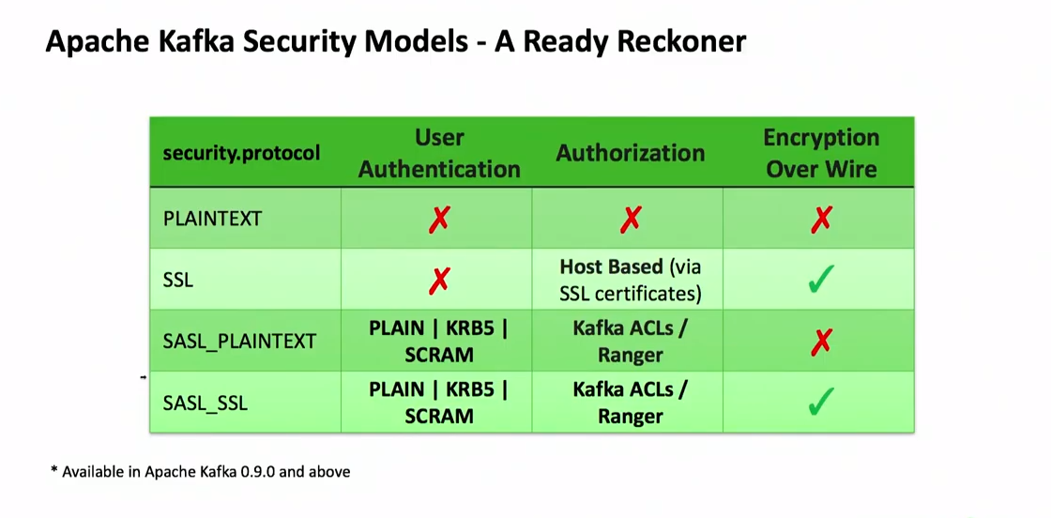

Slide 36
Authorization
Control which permission each authenticated principal has
Pluggable with a default implementation

Slide 37
Authorizer
Controls who can do what
Pluggable
Acl based approach

Slide 38
Principal
PrincipalType:Name
Supported types: User
Extensible so users can add their own types
Wild Card User:*

Slide 39
Permissions
Allow and Deny
Anyone without an explicit Allow ACL is denied
Then why do we have Deny?
Deny works as negation
Deny takes precedence over Allow Acls

Slide 40
Hosts
Why provide this granularity?
Allows authorizer to provide firewall type security even in non secure environment.
* as Wild card.

Slide 41
Configuration
Authorizer class
Super users
Authorizer properties
Default behavior for resources with no ACLs

Slide 42
SimpleAclAuthorizer
Out of box authorizer implementation.
Stores all of its ACLs in zookeeper.
In built ACL cache to avoid performance penalty.
Provides authorizer audit log.

Slide 43
ACL
Alice is Allowed to Read from topic T1 from Host1
Principal
Permission
Operation
Resource
Host
Alice
Allow
Read
Topic:T1
Host1

Slide 44
CLI
Add, Remove and List acls
Convenience options:
--producer and --consumer.

Slide 45
Operations and Resources
Operations
Read, Write, Create, Describe, ClusterAction, All
Resources
Topic, Cluster and ConsumerGroup
Operations | Resources
Read, Write, Describe (Read, Write implies Describe) | Topic
Read | ConsumerGroup
Create, ClusterAction (communication between controller and brokers) | Cluster

Slide 46
SimpleAclAuthorizer
Out of box authorizer implementation.
CLI tool for adding/removing acls
ACLs stored in zookeeper and propagated to brokers asynchronously
ACL cache in broker for better performance.

Slide 47
Authorizer Flow
Client
Broker
Authorizer
Zookeeper
configure
Read ACLs
Load Cache
Request
authorize
ACL match
Or Super User?
Allowed/Denied

Slide 48
Configure broker ACL
authorizer.class.name=kafka.security.auth.SimpleAclAuthorizer
Make Kafka principal super users
Or grant ClusterAction and Read all topics to Kafka principal

Slide 49
Configure client ACL
Producer
Grant Write on topic, Create on cluster (auto creation)
Or use --producer option in CLI
bin/kafka-acls --authorizer-properties zookeeper.connect=localhost:2181 \
--add --allow-principal User:Bob --producer --topic t1
Consumer
Grant Read on topic, Read on consumer group
Or use --consumer option in CLI
bin/kafka-acls --authorizer-properties zookeeper.connect=localhost:2181 \
--add --allow-principal User:Bob --consumer --topic t1 --group group1

Slide 50
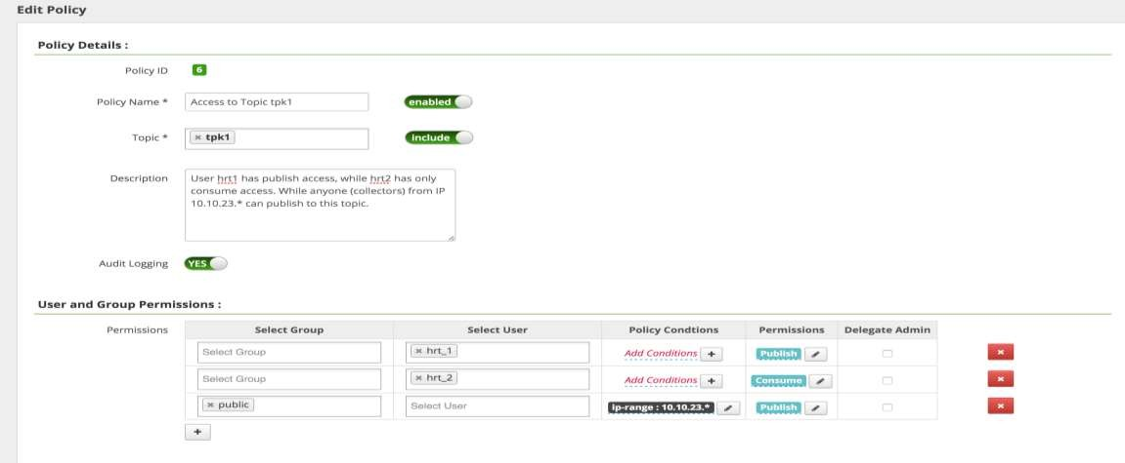
Ranger Policy

Slide 51
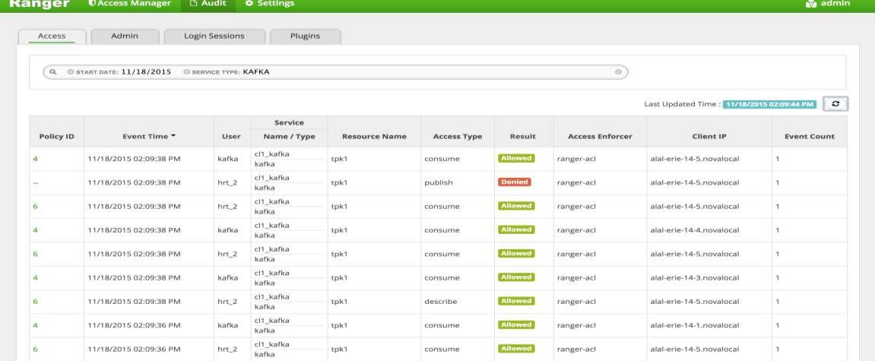
Ranger Auditing

Slide 52
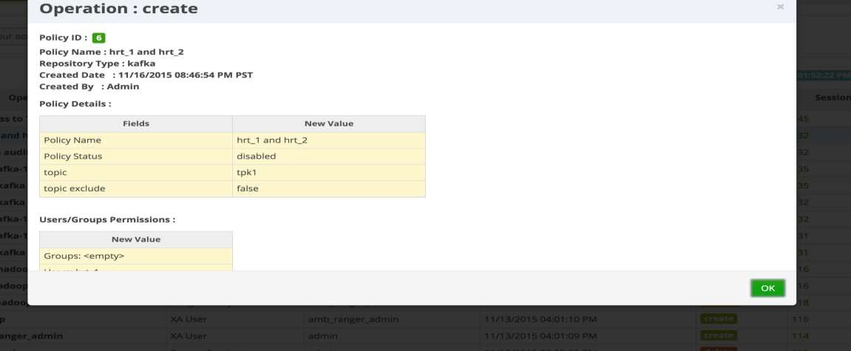
Ranger ACL management Audit

Slide 53
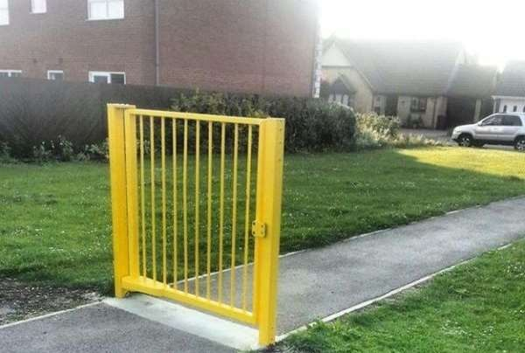
Unsecure zookeeper

Slide 54
Secure Zookeeper
Zookeeper stores
critical Kafka metadata
ACLs
Need to prevent untrusted users from modifying

Slide 55
Zookeeper Security Integration
ZK supports authentication through SASL
Kerberos or Digest MD5
Set zookeeper.set.acl to true on every broker
Configure ZK user through JAAS config file
Each ZK path writable by creator, readable by all

Slide 56
Migrating from non-secure to secure Kafka
Configure brokers with multiple ports
listeners=PLAINTEXT://host.name:port,SSL://host.name:port
Gradually migrate clients to secure port
When done
Turn off PLAINTEXT port on brokers

Slide 57
Migrating from non-secure to secure Zookeeper
http://kafka.apache.org/documentation.html#zk_authz_migration

Slide 58
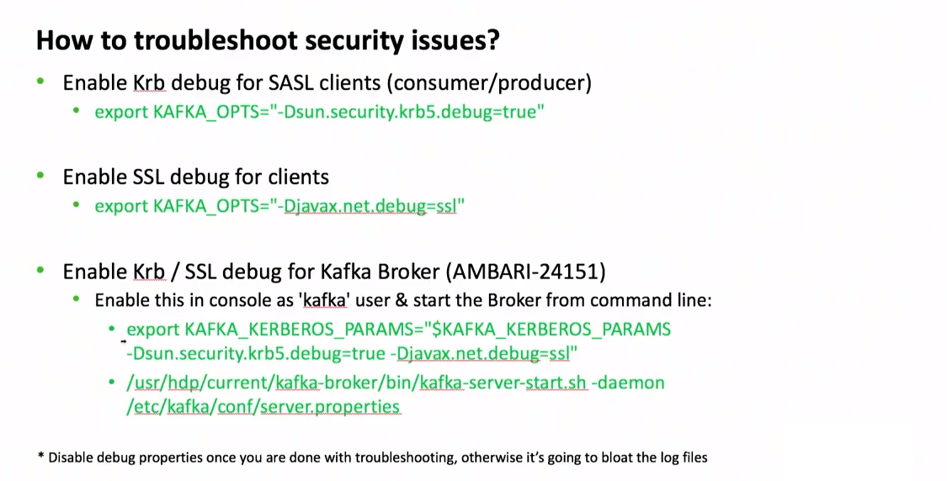

Slide 59
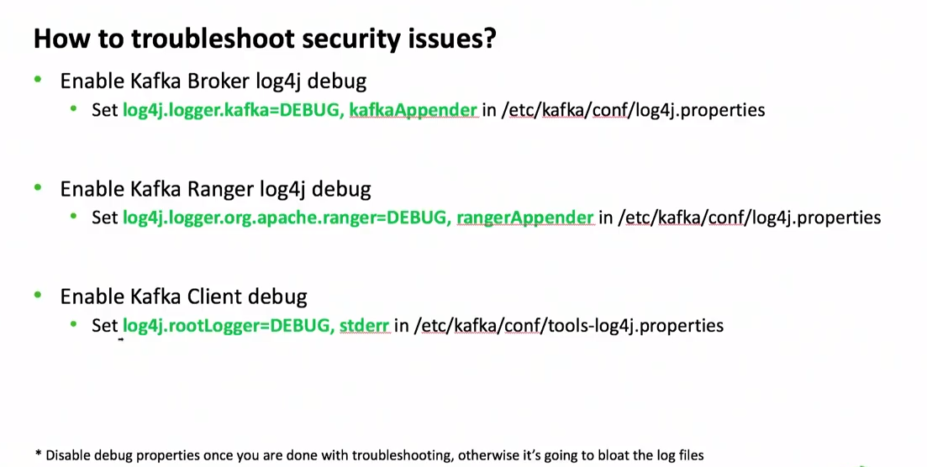

Slide 60
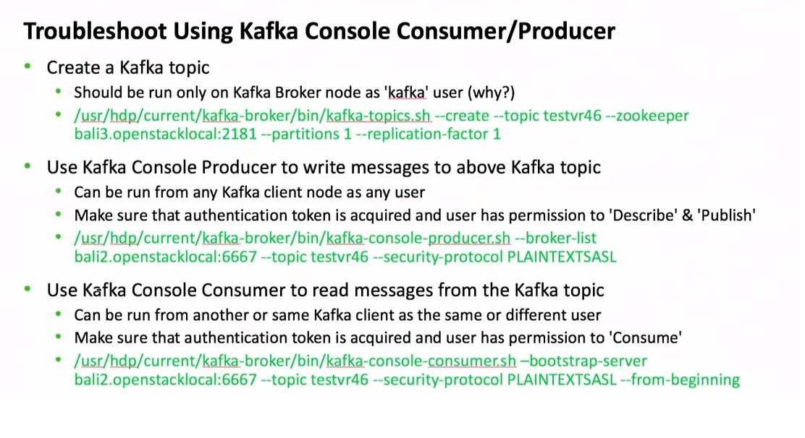

Slide 61
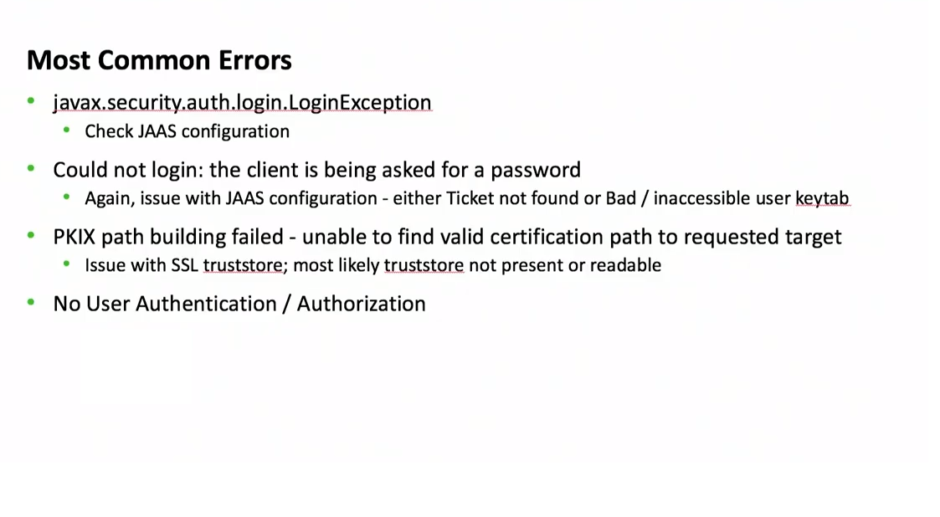

Slide 62
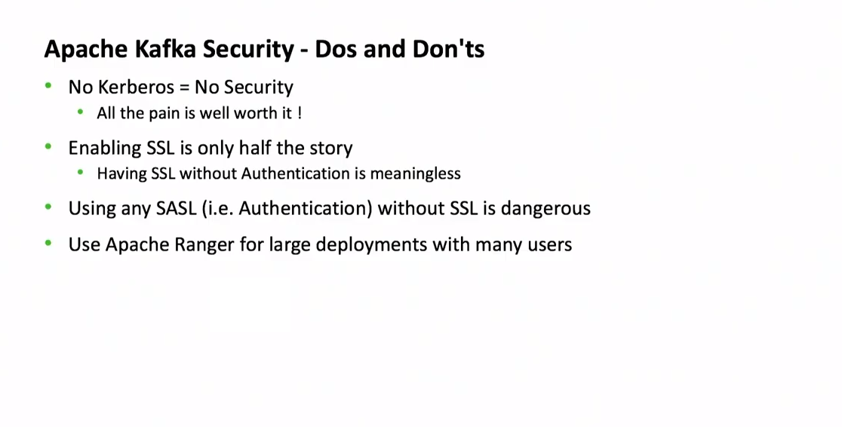

Slide 63
Thank You

